Slide 1
Mobile Computing
Project Presentation

Slide 2

HealthMate
An All-in-one
Health Care App

Slide 3
1.
Project Idea

Slide 4

Unaware of
medical history
of loved ones
Reminder for doctor appointments
Sedentary
lifestyle
Forget to
take medicine
on time
Need for a
one-stop solution
Notes:
Sedentary : COVID
Old age

Slide 5
2.
Features

Slide 6
The features offered by the application are :
Patient’s Login & Registration Portal
Doctor’s Login & Registration Portal
Multiple profiles with single login
Scheduling doctor appointments
Digitalization of prescriptions and scan reports
Reminder alarms for medicine intake
Emergency SOS Service
Activity tracker

Slide 7
3.
Features Implemented

Slide 8
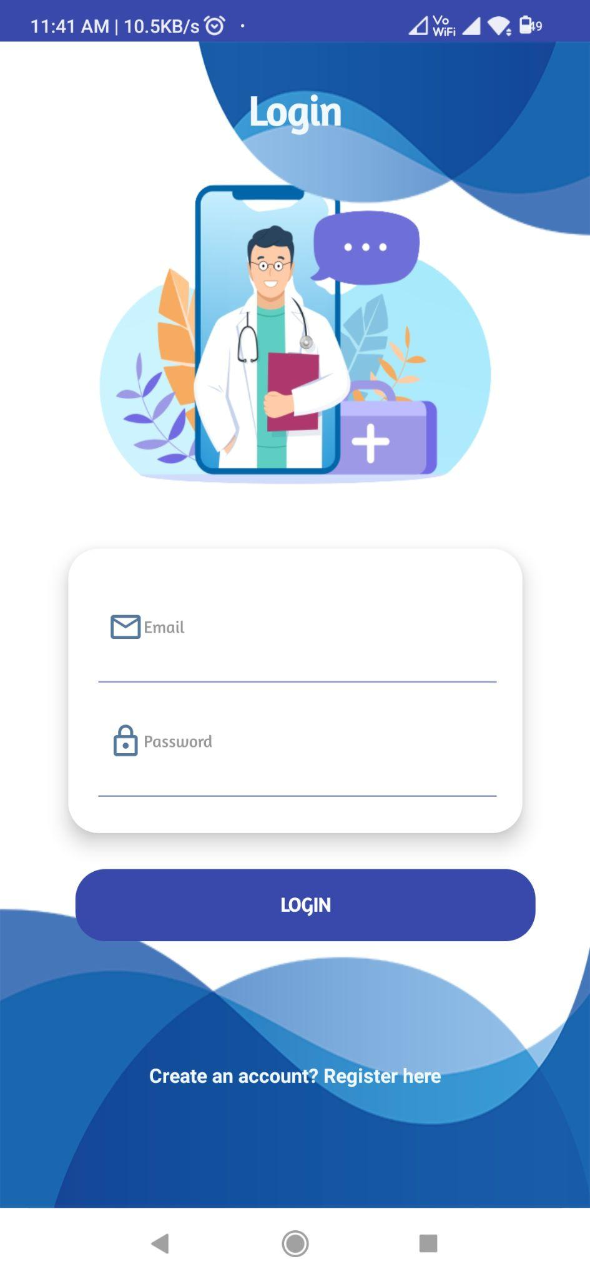
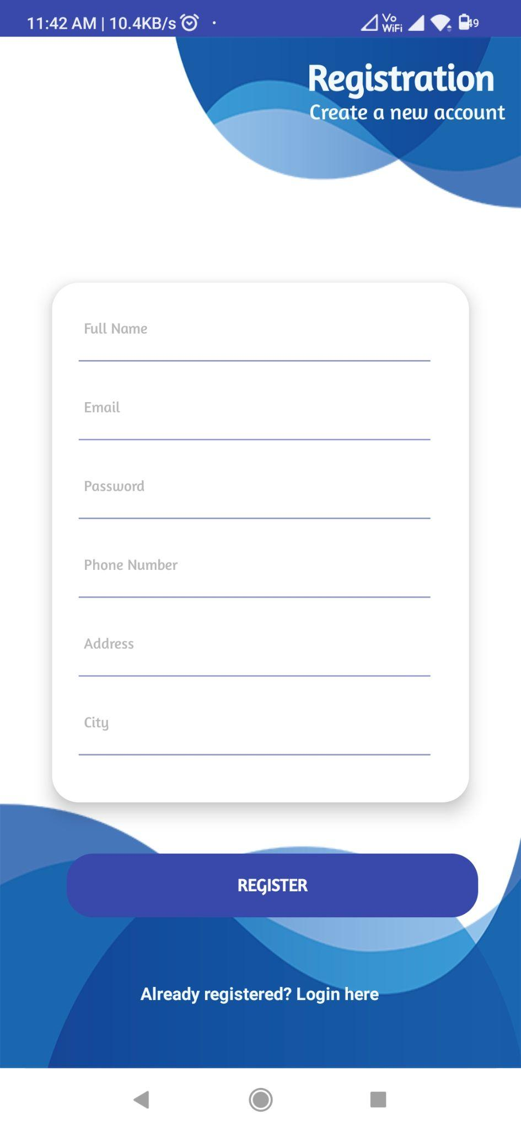
Login
Registration

Slide 9
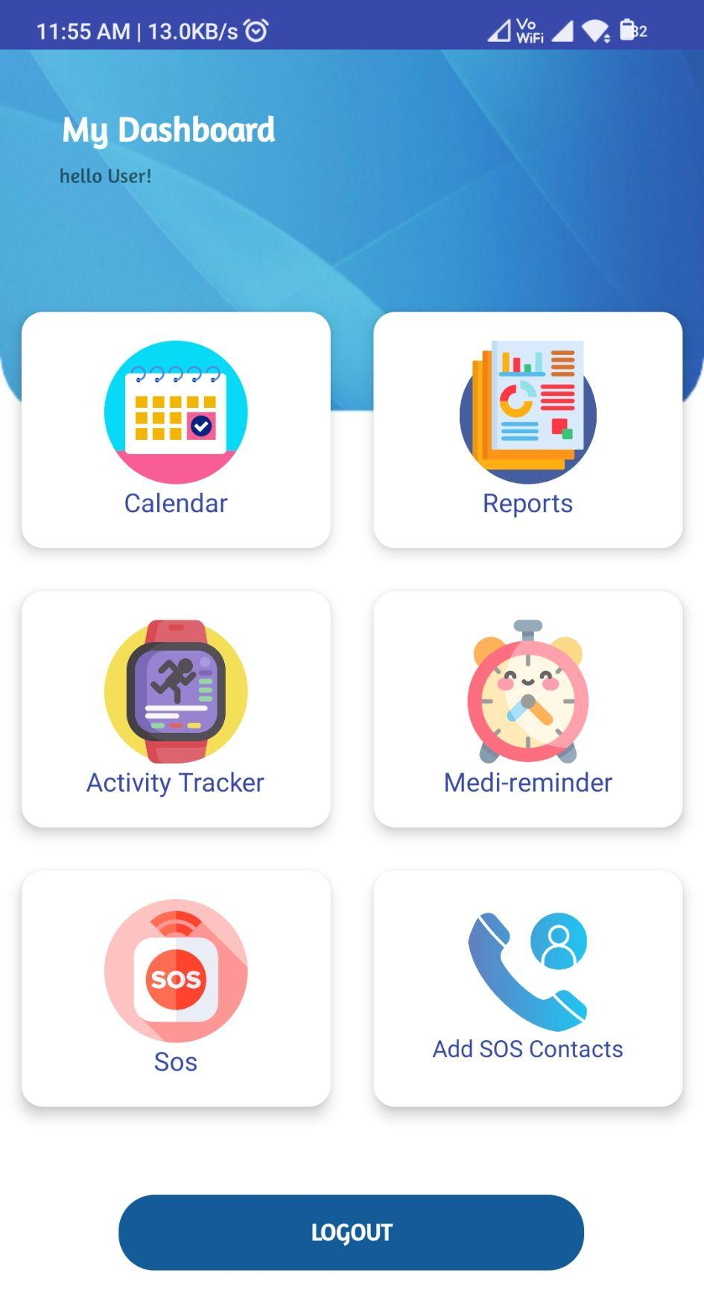
Dashboard
Appointments
Patient Reports
Activity Tracker
Medicine Reminder
SOS
Notes:
specialisation of doctor -> suggest doctors and their timings
(future work: doctor separately can register)
Patients reports scan, if possible transcribe and store in db
Activity tracker: steps and calories burnt
Medicine reminder: alarm like at pre-scheduled time
SOS: medical emergency message/ notification

Slide 10
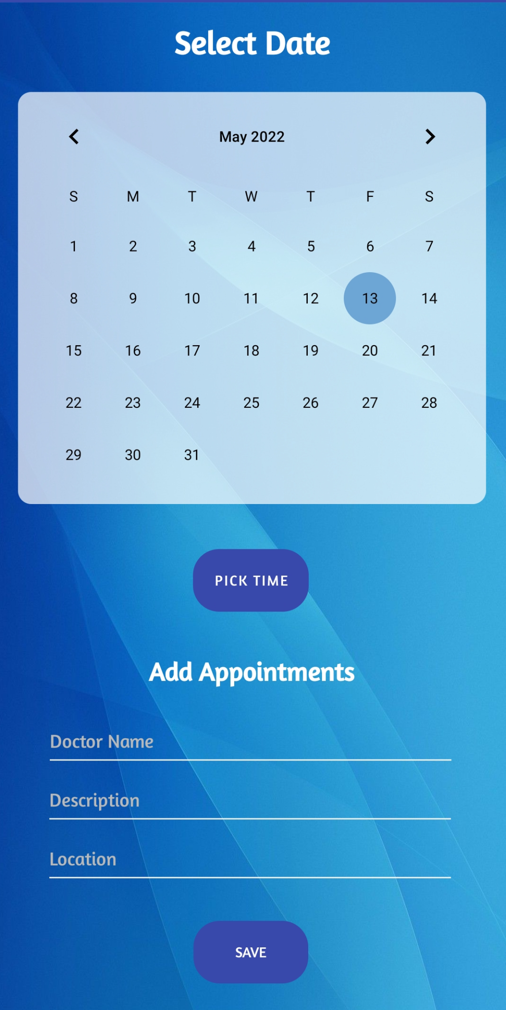
Calendar for
scheduling appointments

Slide 11
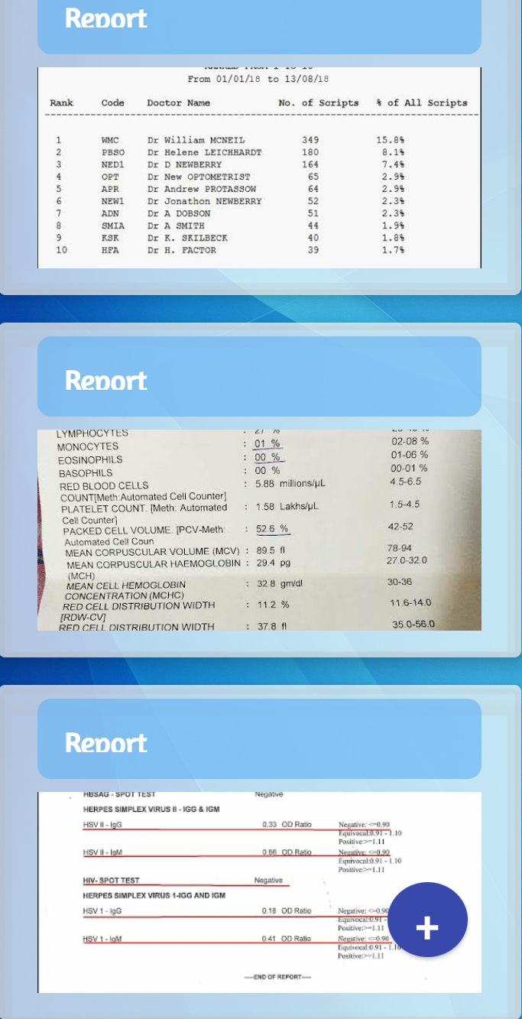
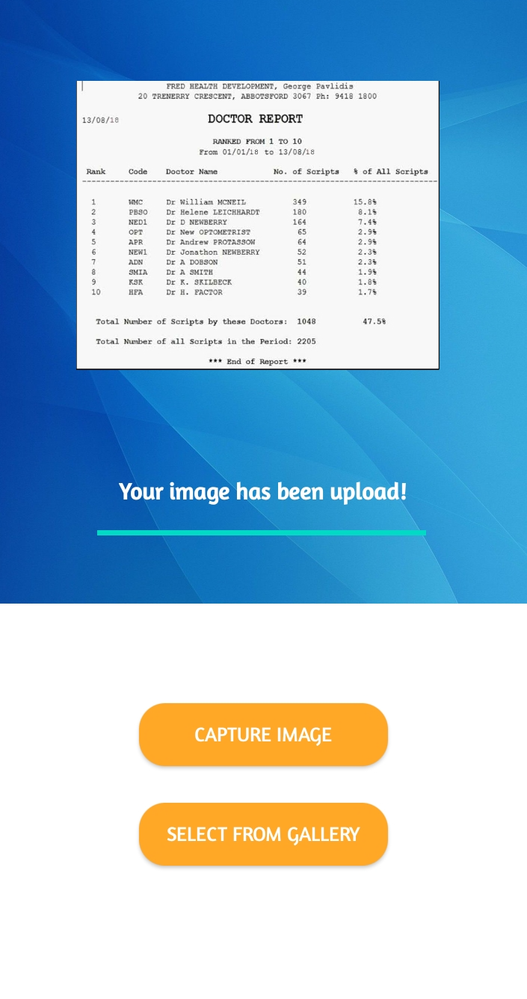
Reports
Notes:
specialisation of doctor -> suggest doctors and their timings
(future work: doctor separately can register)
Patients reports scan, if possible transcribe and store in db
Activity tracker: steps and calories burnt
Medicine reminder: alarm like at pre-scheduled time
SOS: medical emergency message/ notification

Slide 12
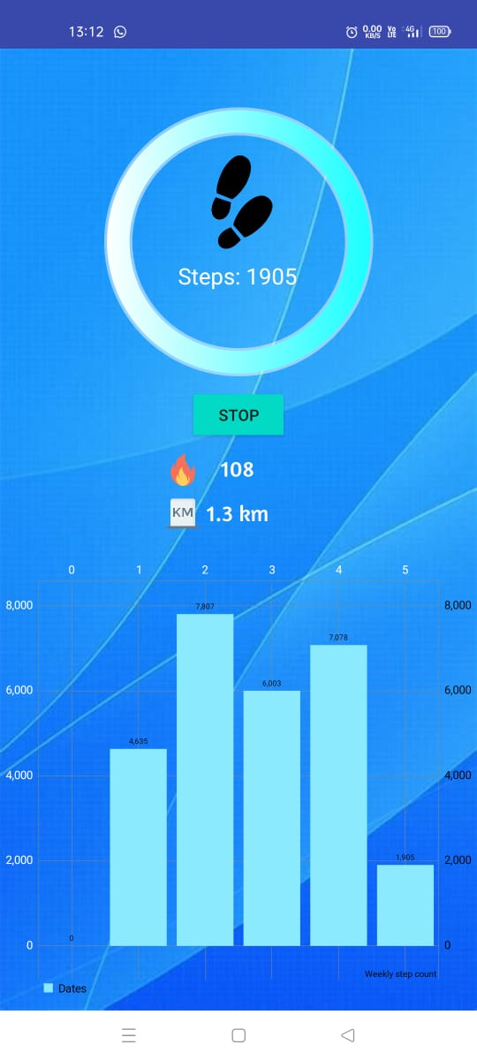
Activity
Tracker

Slide 13
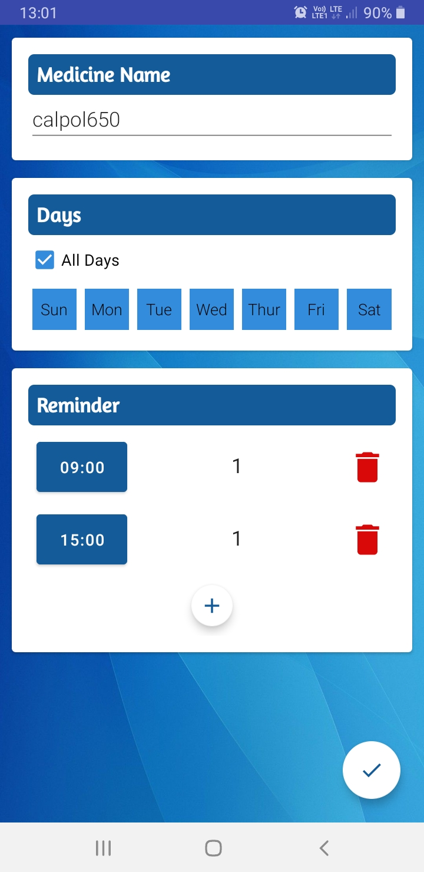
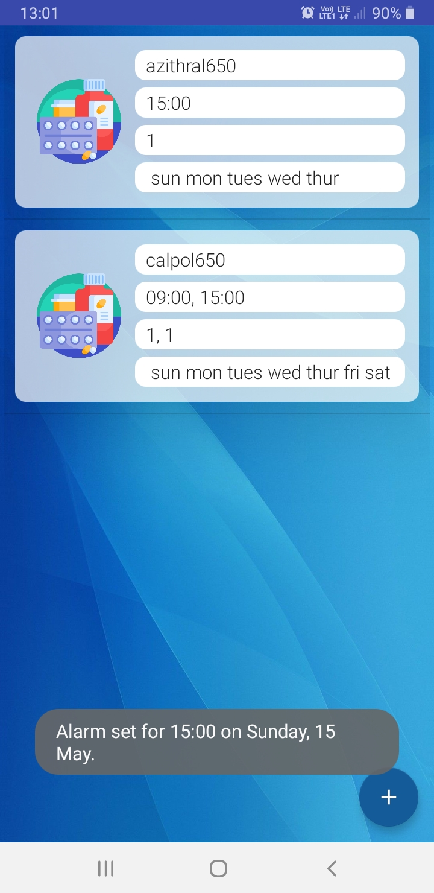
Medicine Reminder

Slide 14
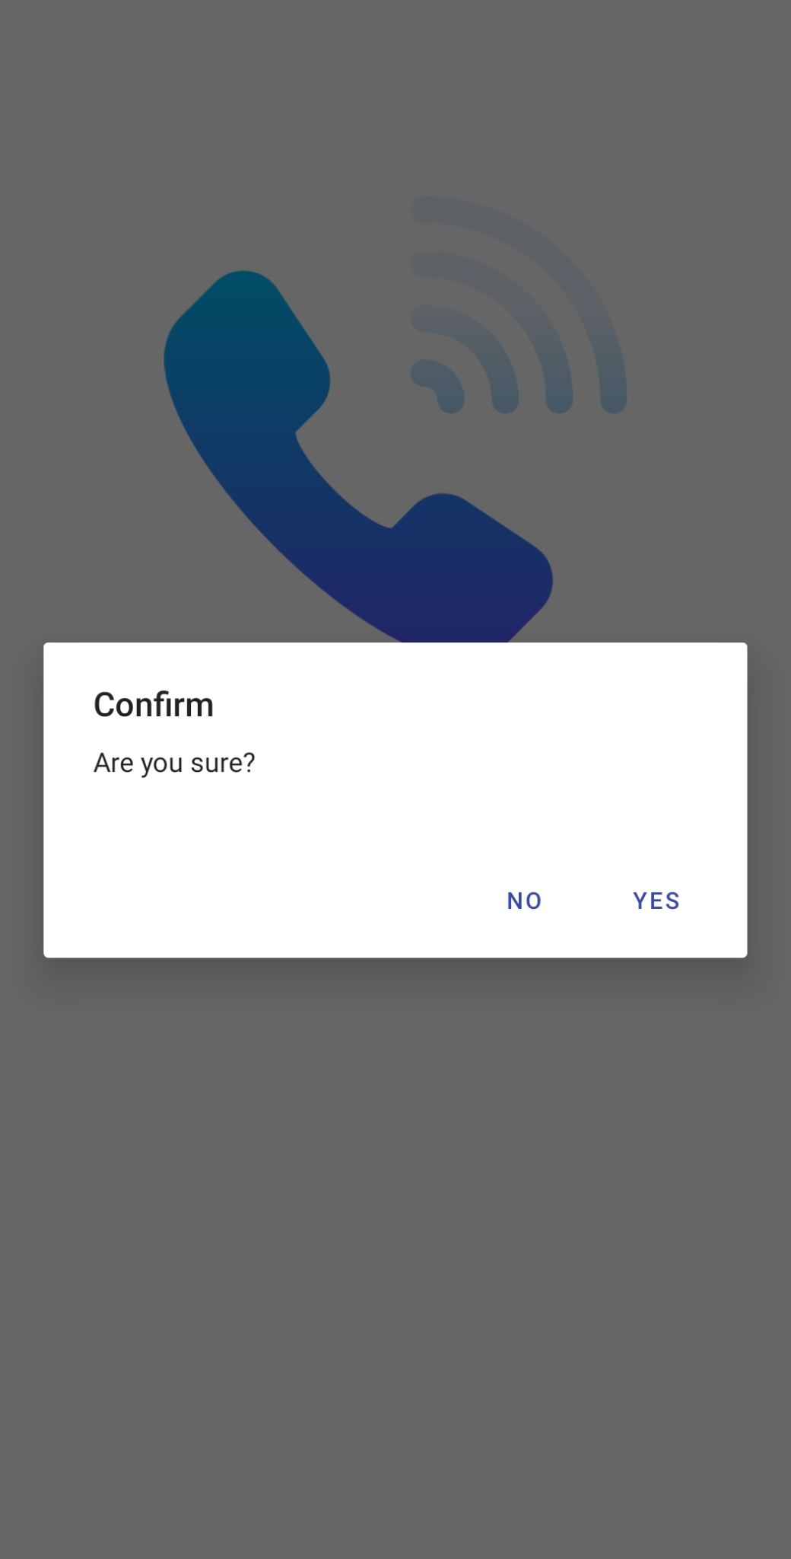
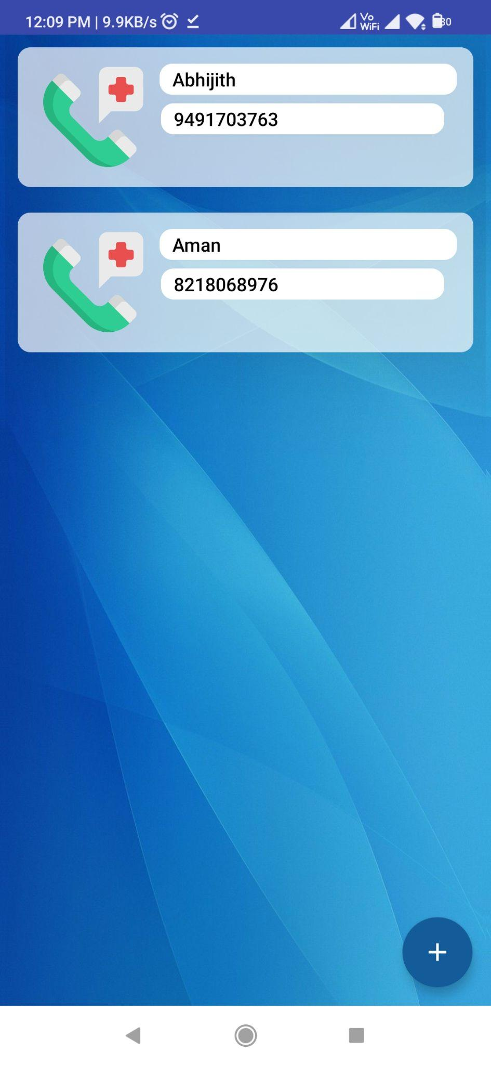
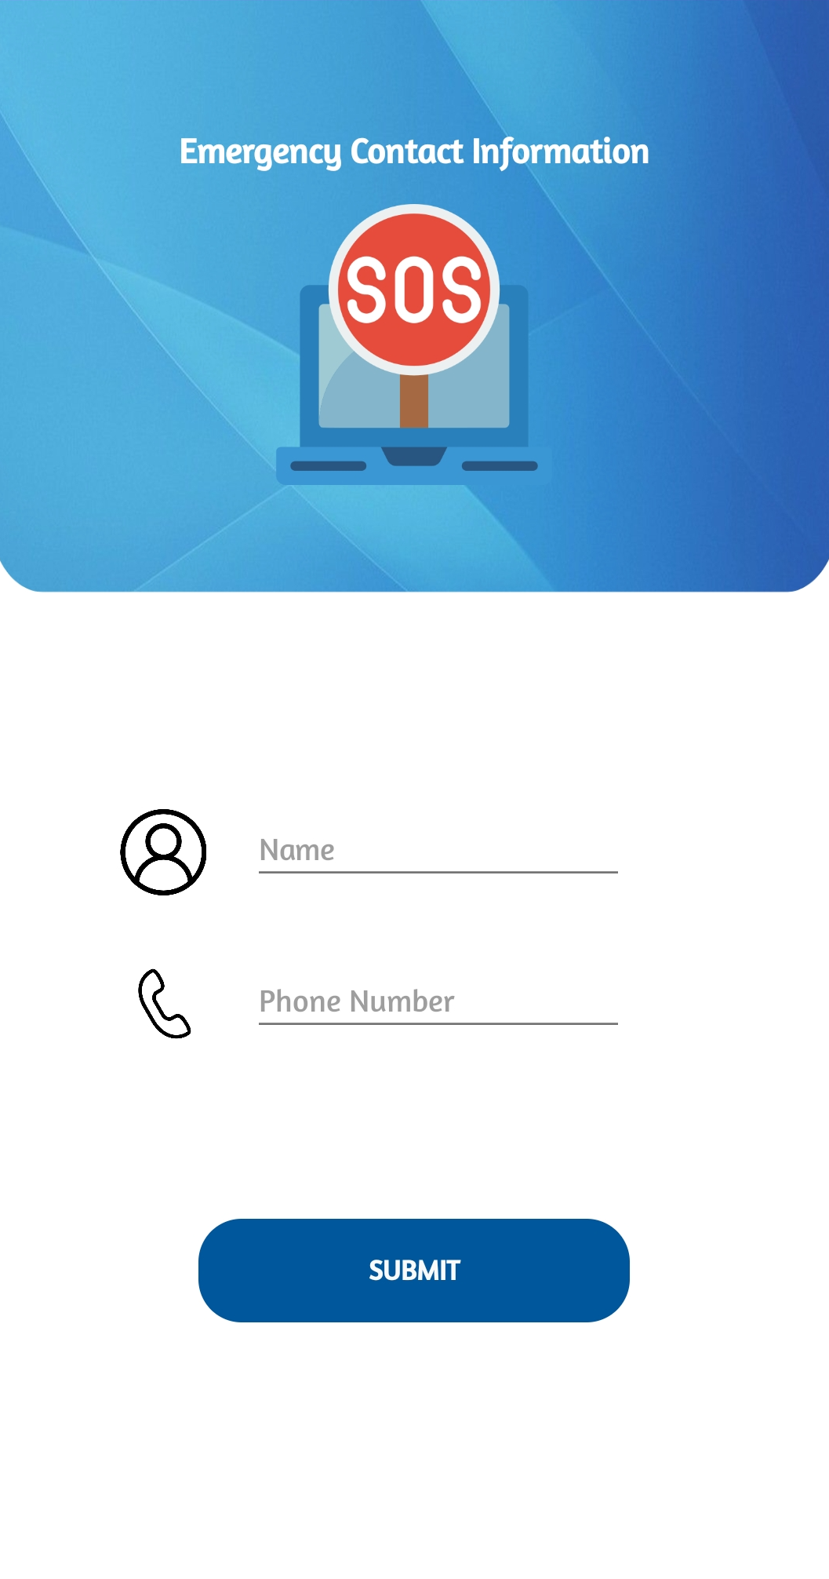
SOS

Slide 15


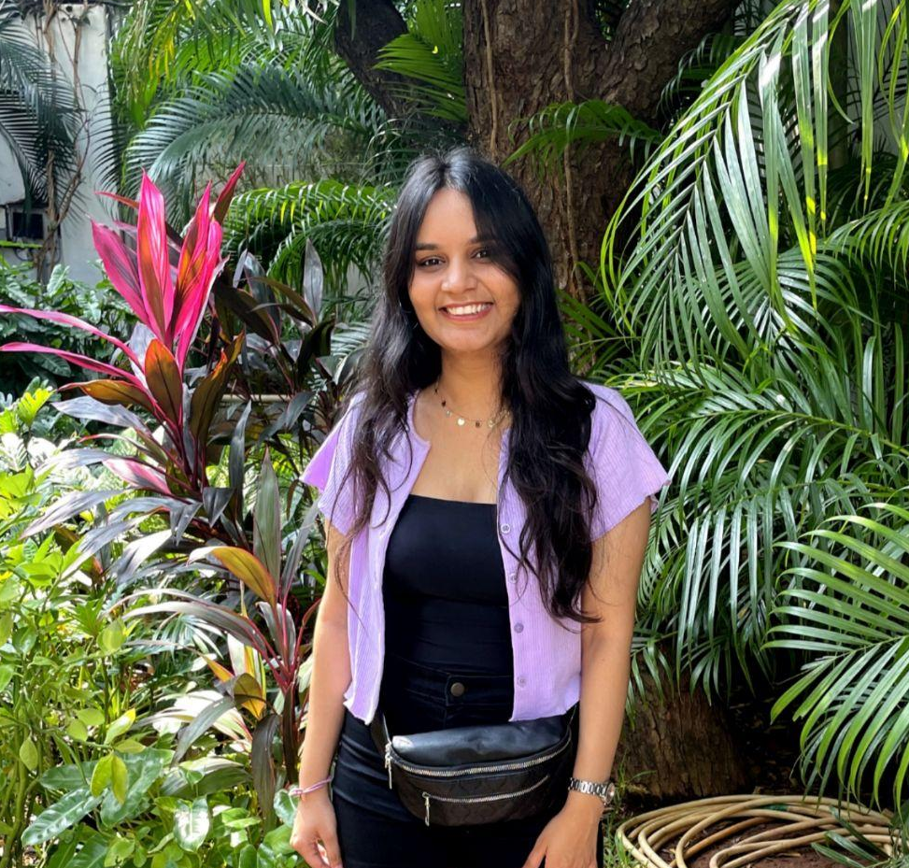
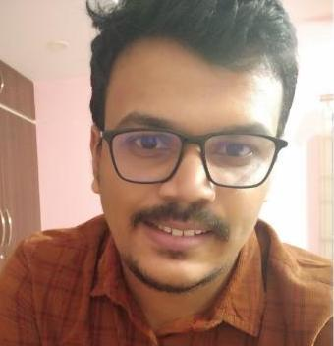
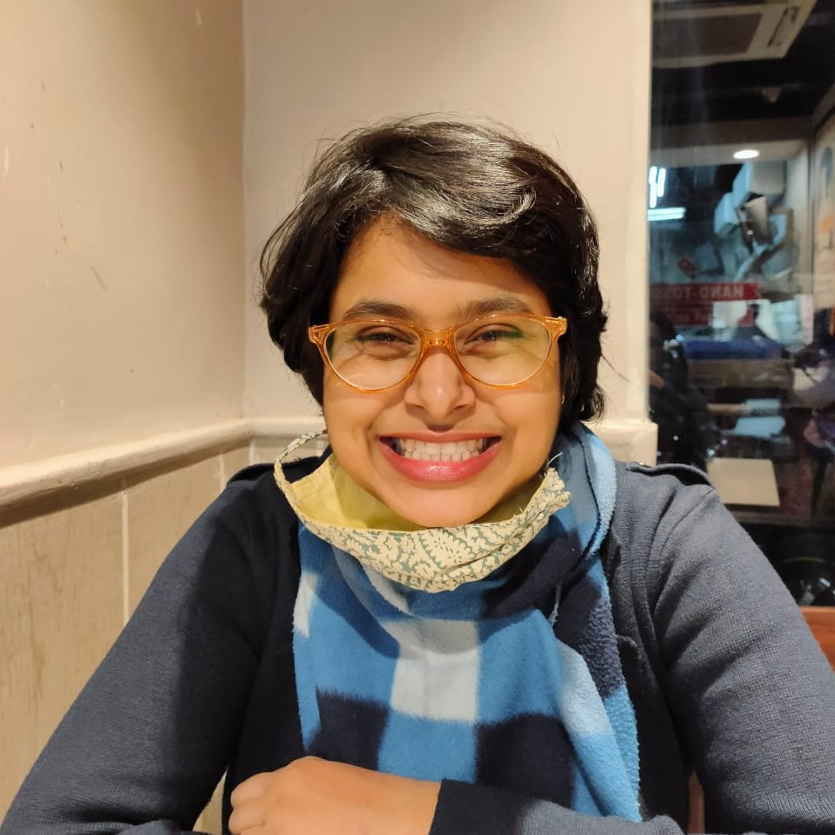
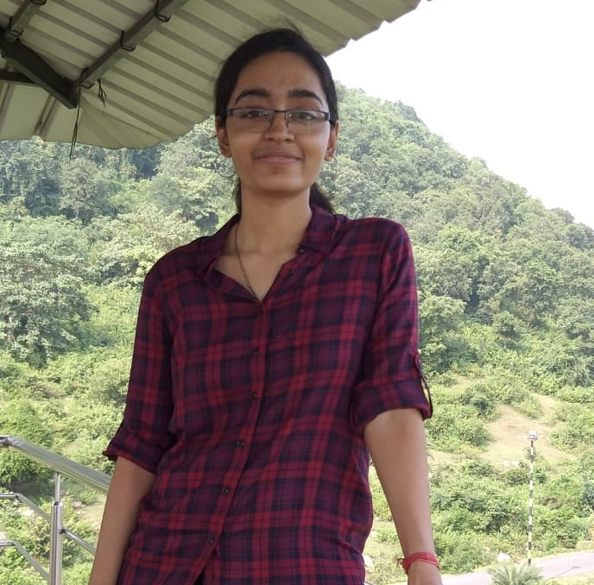

Group Contribution :
K kie
Jar
Nehal Chourasia
MT21056
Abhijith P.
MT21059
Aman Srivastava
MT21007
Ishita Mandal
MT21029
Sanchita Saha
MT21075
SOS feature(Calling and messaging) implementation & its UI
Add SOS contacts implementation using recycler view for dynamic updation & its UI
Database handling for SOS, login & registration.
Login & Registration with fragments.
Documentation
Calendar Activity for scheduling Appointments
Calendar Activity Dynamic UI
Storing Captured images URL to firebase database
Capture Activity RecyclerView
Database Creation & Connectivity
Registration & Login with fragments
Documentation
Design the UI of Medicine Reminder
Fragment for Add Medicine and Database Updation
RecyclerView for Medicine List
Dynamic View for dosage and time addition
Alarm Integration and medicine removal by swiping
Design the UI of all the components like login, registration, dashboard, medicine component and reports.
Camera activity: Capture image from Camera.
Upload the images from gallery and to database storage.
Helped with the different functionalities of the application.
Design the UI of Medicine Reminder
Activity Tracker using google fit Api
OAuth, Sensing, recording and history client.
Activity Tracker UI
Weekly Data graph
Documentation

Slide 16
Thank You

